Slide 1
Writing a simple Publisher and Subscriber
(Talker / Listener)
(C++ and Python)

Slide 2
Writing a Simple Publisher and Subscriber (C++) http://wiki.ros.org/ROS/Tutorials/WritingPublisherSubscriber%28c%2B%2B%29
Examining the Simple Publisher and Subscriber
http://wiki.ros.org/ROS/Tutorials/ExaminingPublisherSubscriber

Slide 3
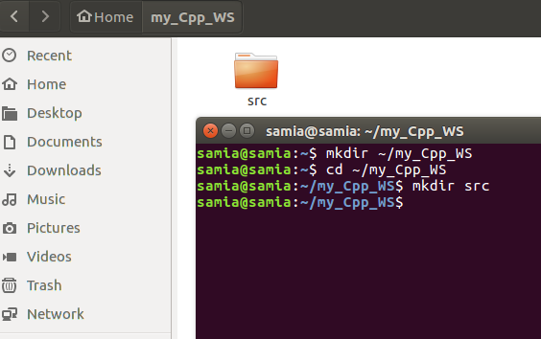
Start by creating a ROS Workspace
Create a folder in the home file under the name my_Cpp_WS
Change the directory to the folder created
Create an src file in which the ROS Package will be created

Slide 4
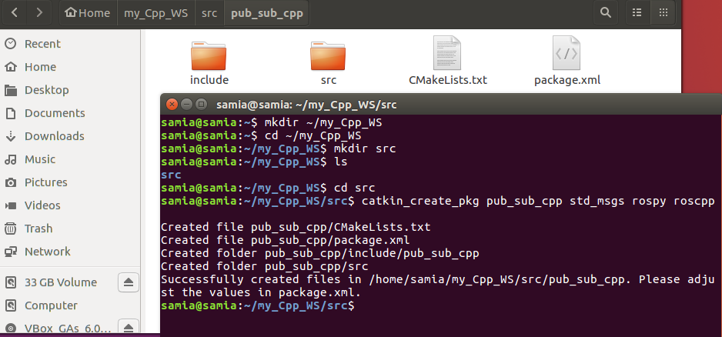
Create a ROS Package
Explore my_Cpp_WS
Go to the src file
Use the catkin_create_pkg command the create a ROS Package under the name pub_sub_cpp

Slide 5
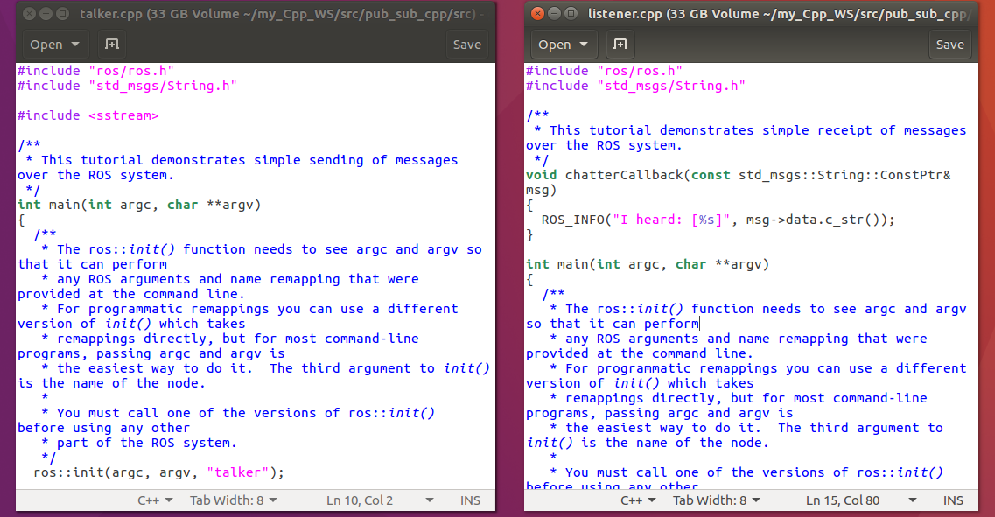
The src file in the pub_sub_cpp package will include the talker.cpp and listener.cpp nodes

Slide 6
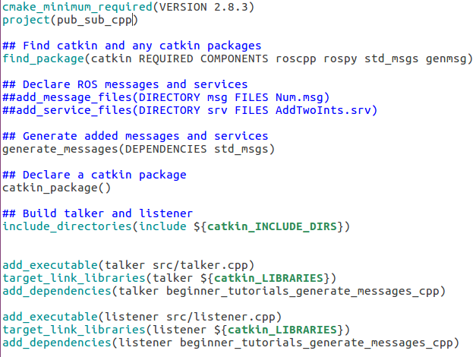
Edit CMakeLists.txt file

Slide 7
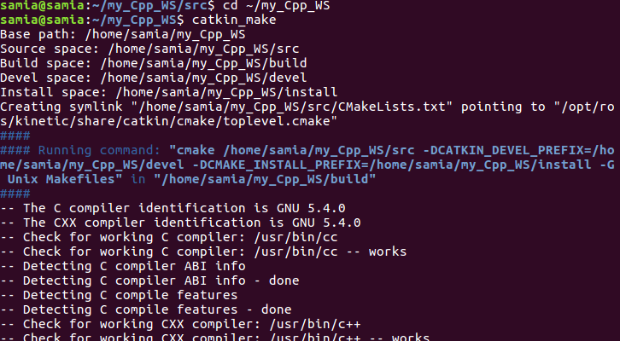
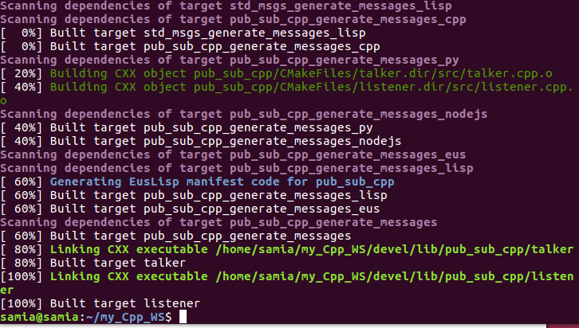
Build the codes

Slide 8
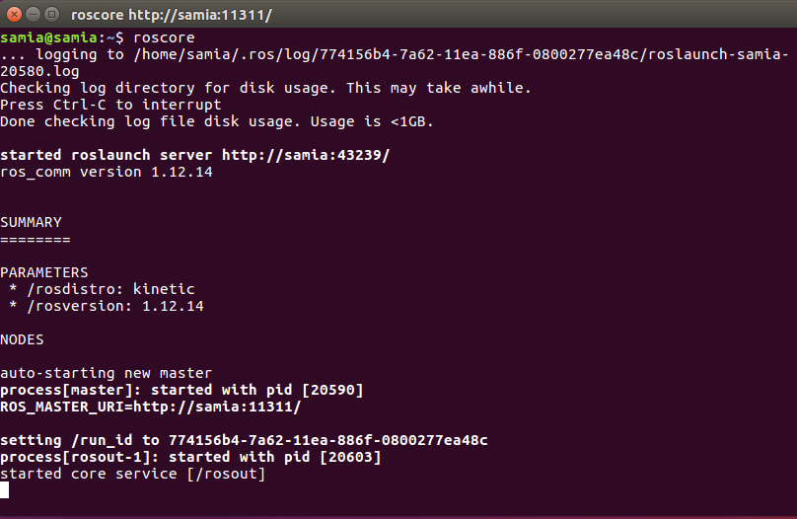
Run Ros in one terminal using roscore

Slide 9
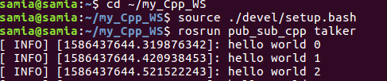
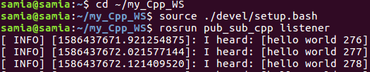
Run the two nodes

Slide 10
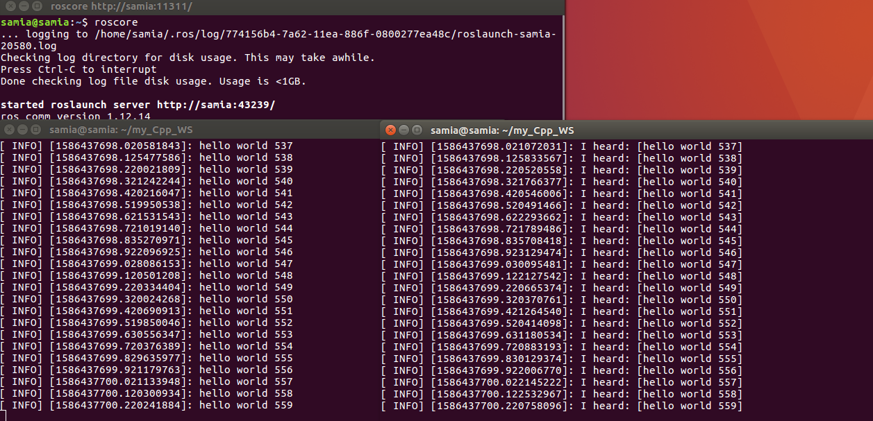
Result

Slide 11
Writing a Simple Publisher and Subscriber (Python) http://wiki.ros.org/ROS/Tutorials/WritingPublisherSubscriber%28python%29
Examining the Simple Publisher and Subscriber
http://wiki.ros.org/ROS/Tutorials/ExaminingPublisherSubscriber

Slide 12
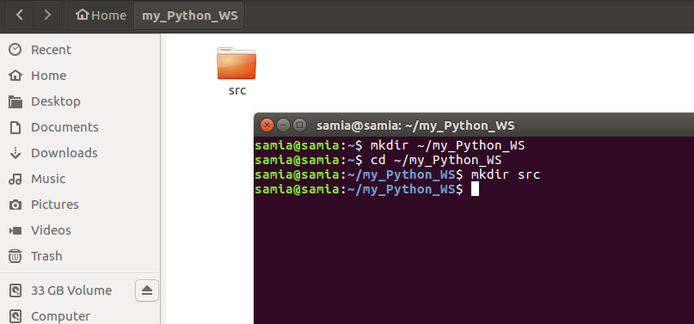
Start by creating a ROS Workspace
Create a folder in the home file under the name my_Python_WS
Change the directory to the folder created
Create an src file in which the ROS Package will be created

Slide 13
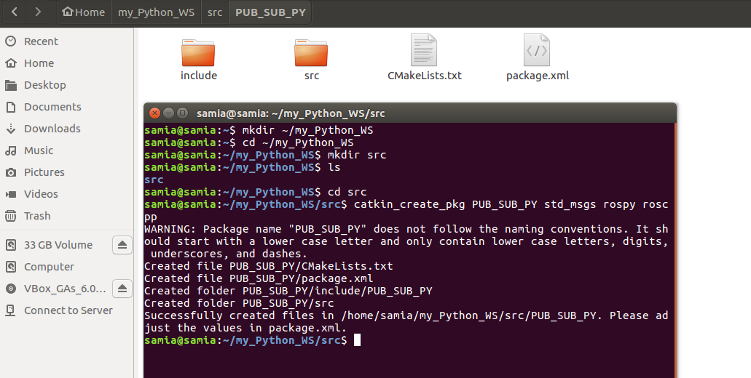
Create a ROS Package
Explore my_Python_WS
Go to the src file
Use the catkin_create_pkg command the create a ROS Package under the name pub_sub_py

Slide 14
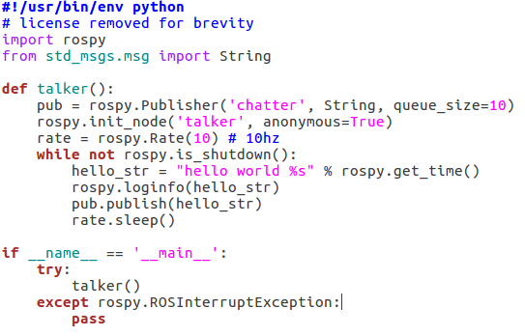
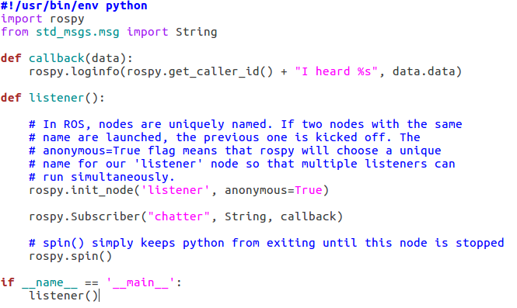
The src file in the pub_sub_py package will include the talker.py and listener.py nodes

Slide 15
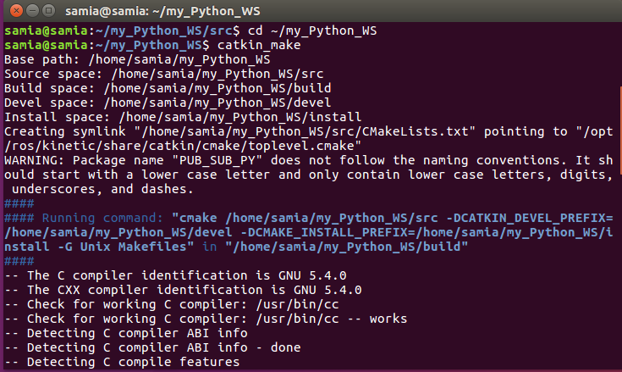
Convert to executable file
Go to the ros workspace
Use the catkin_make command to change the nodes to executable file
Cmake error

